Slide 1
Black hole chemistry
Chandrasekhar PRSLA421:227 (1989); Assumpção+ PRD98: 064036 (2018)
Bernard + PRD100: 044002 (2019)

Slide 2
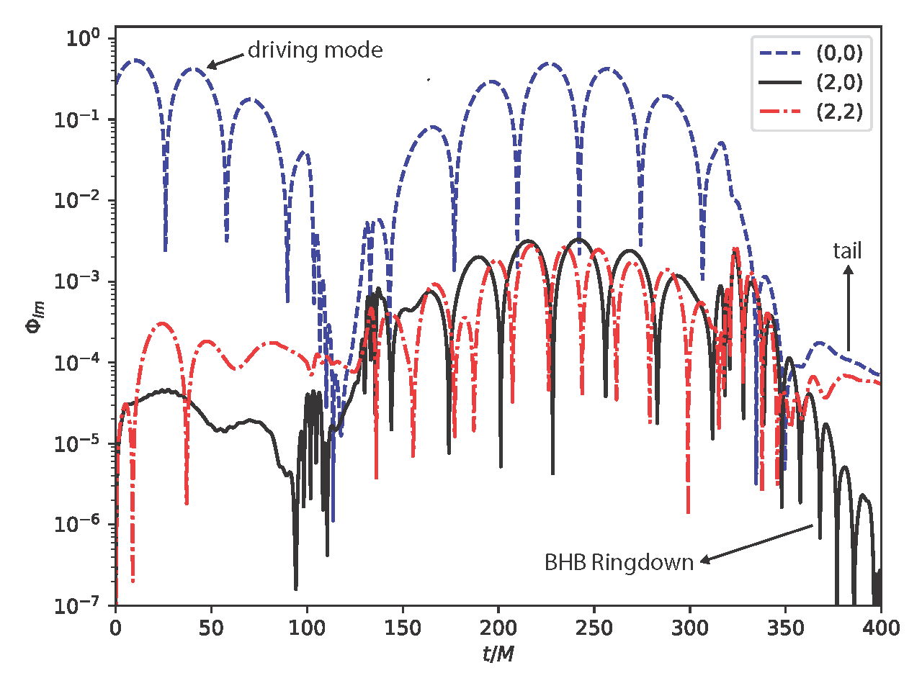
Global BHB modes may be resonantly excited?
Bernard + PRD100: 044002 (2019)

Slide 3
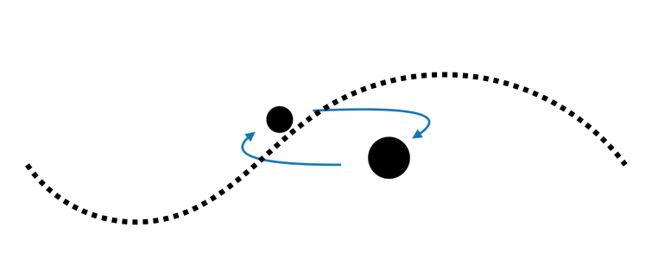
Environments
Different situations in which BHs interact with light field as an environment
Isolated BH or binary BH in scalar field environment:
Backreaction?
BH in dark matter halo
accretion of BS by BH?
Details of process, timescales?
Notes:
Superradiance is one of the typical example of BH as particle detectors. But, we can imagine other situations in which BH can becomes particle detector, and we need to deeply understand these situations.

Slide 4
Gravitational molecule
Accreting large BS into BH
Ikeda + PRD 103 (2021) 2, 024020
Cardoso + PRD 106 (2022) 12, L121302

Slide 5
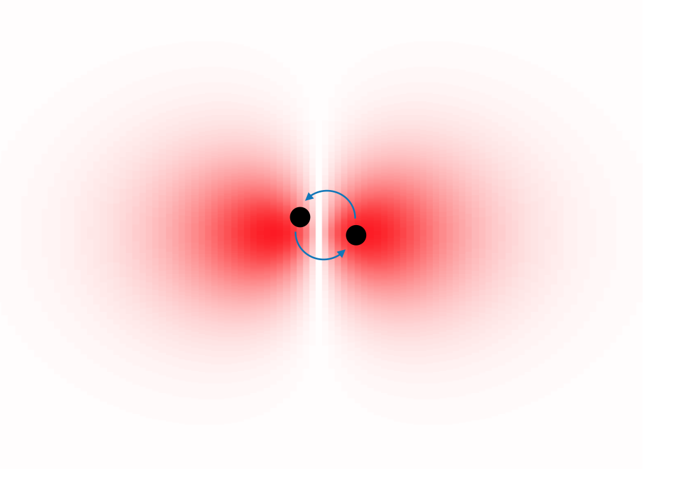
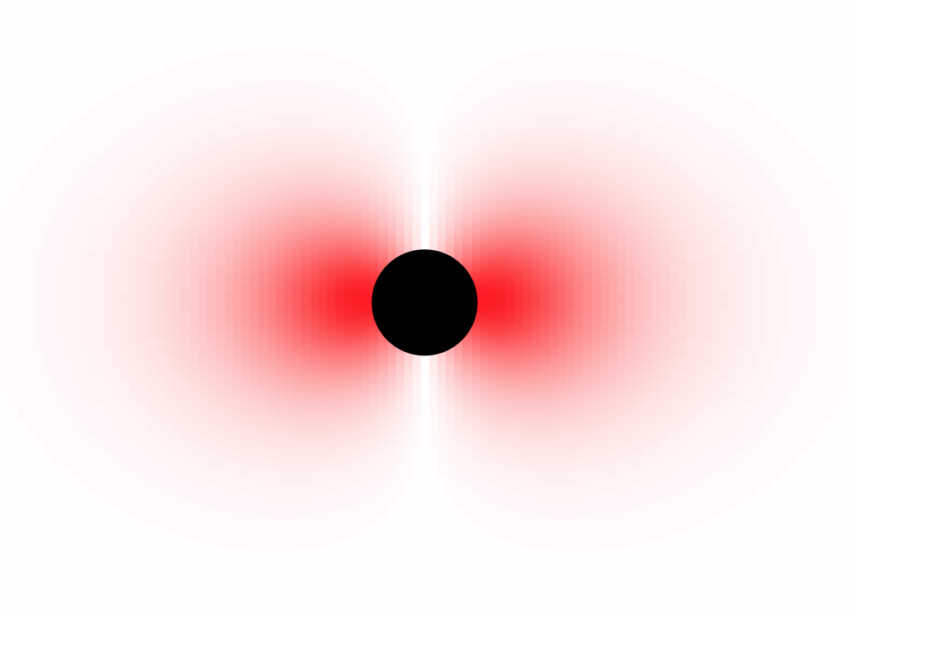
Gravitational molecule
Gravitational atom
Gravitational molecule
$$i∂_{t}φ=\left(−\frac{1}{2μ^{2}}∇^{2}+V(r)\right)φ$$
$$i∂_{t}φ=\left(−\frac{1}{2μ^{2}}∇^{2}+V(r)\right)φ$$
$$V(r)=\frac{μM}{r}$$
$$V(r)=\frac{μM_{1}}{|r−r_{1}(t)|}+\frac{μM_{2}}{|r−r_{2}(t)|}$$
Hydrogen atom
Di-hydrogen molecule
spectrum of molecule

Slide 6
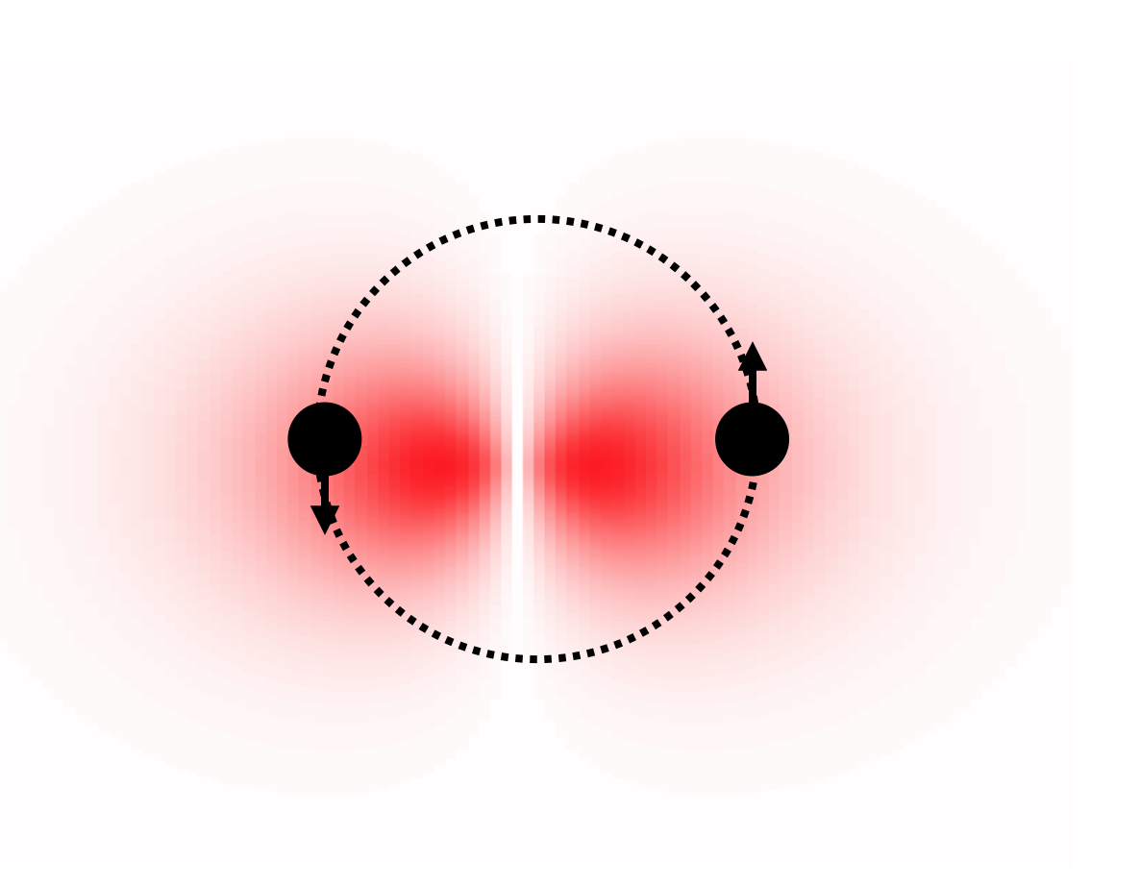
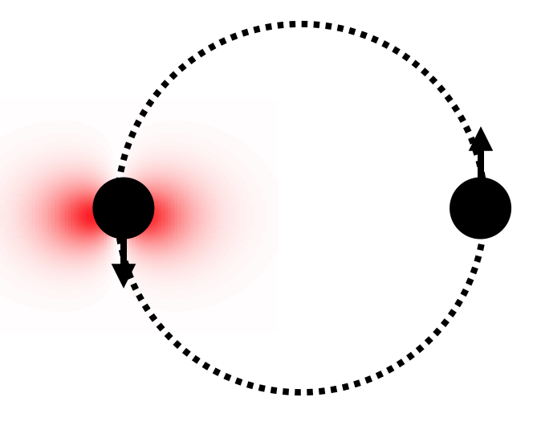
Typical length scale
$$\left(□−μ^{2}\right)φ=0$$
$$M_{1}=M_{2}=\frac{M}{2}$$
$$(Mμ^{2})^{−1}$$
$$D$$
$$(M_{1}μ^{2})^{−1}$$
$$(M_{1}μ^{2})^{−1}≪D$$
gravitational atom around individual BH
$$(Mμ^{2})^{−1}≳D$$
gravitational molecule around BH binary

Slide 7
$$D=60M$$
$$μM=0.5$$
$$w=25M$$
$$(M_{1}μ^{2})^{−1}≪D$$
Simulation 1 : Gaussian initial data
Ikeda + PRD 103 (2021) 2, 024020

Slide 8
Simulation 1
Scalar field
Energy density
Gravitational atom around individual BHs
Ikeda + PRD 103 (2021) 2, 024020

Slide 9
$$D=10M,60M$$
$$μM=0.2$$
$$w=25M$$
$$(Mμ^{2})^{−1}≳D$$
Simulation 2 : Gaussian initial data
Ikeda + PRD 103 (2021) 2, 024020

Slide 10
Simulation 2
Scalar field
$$D=60M$$
Energy density
“Monopole” gravitational molecule around BH binary
We checked the spectrum is similar to Di-hyrogen molecule

