Slide 1
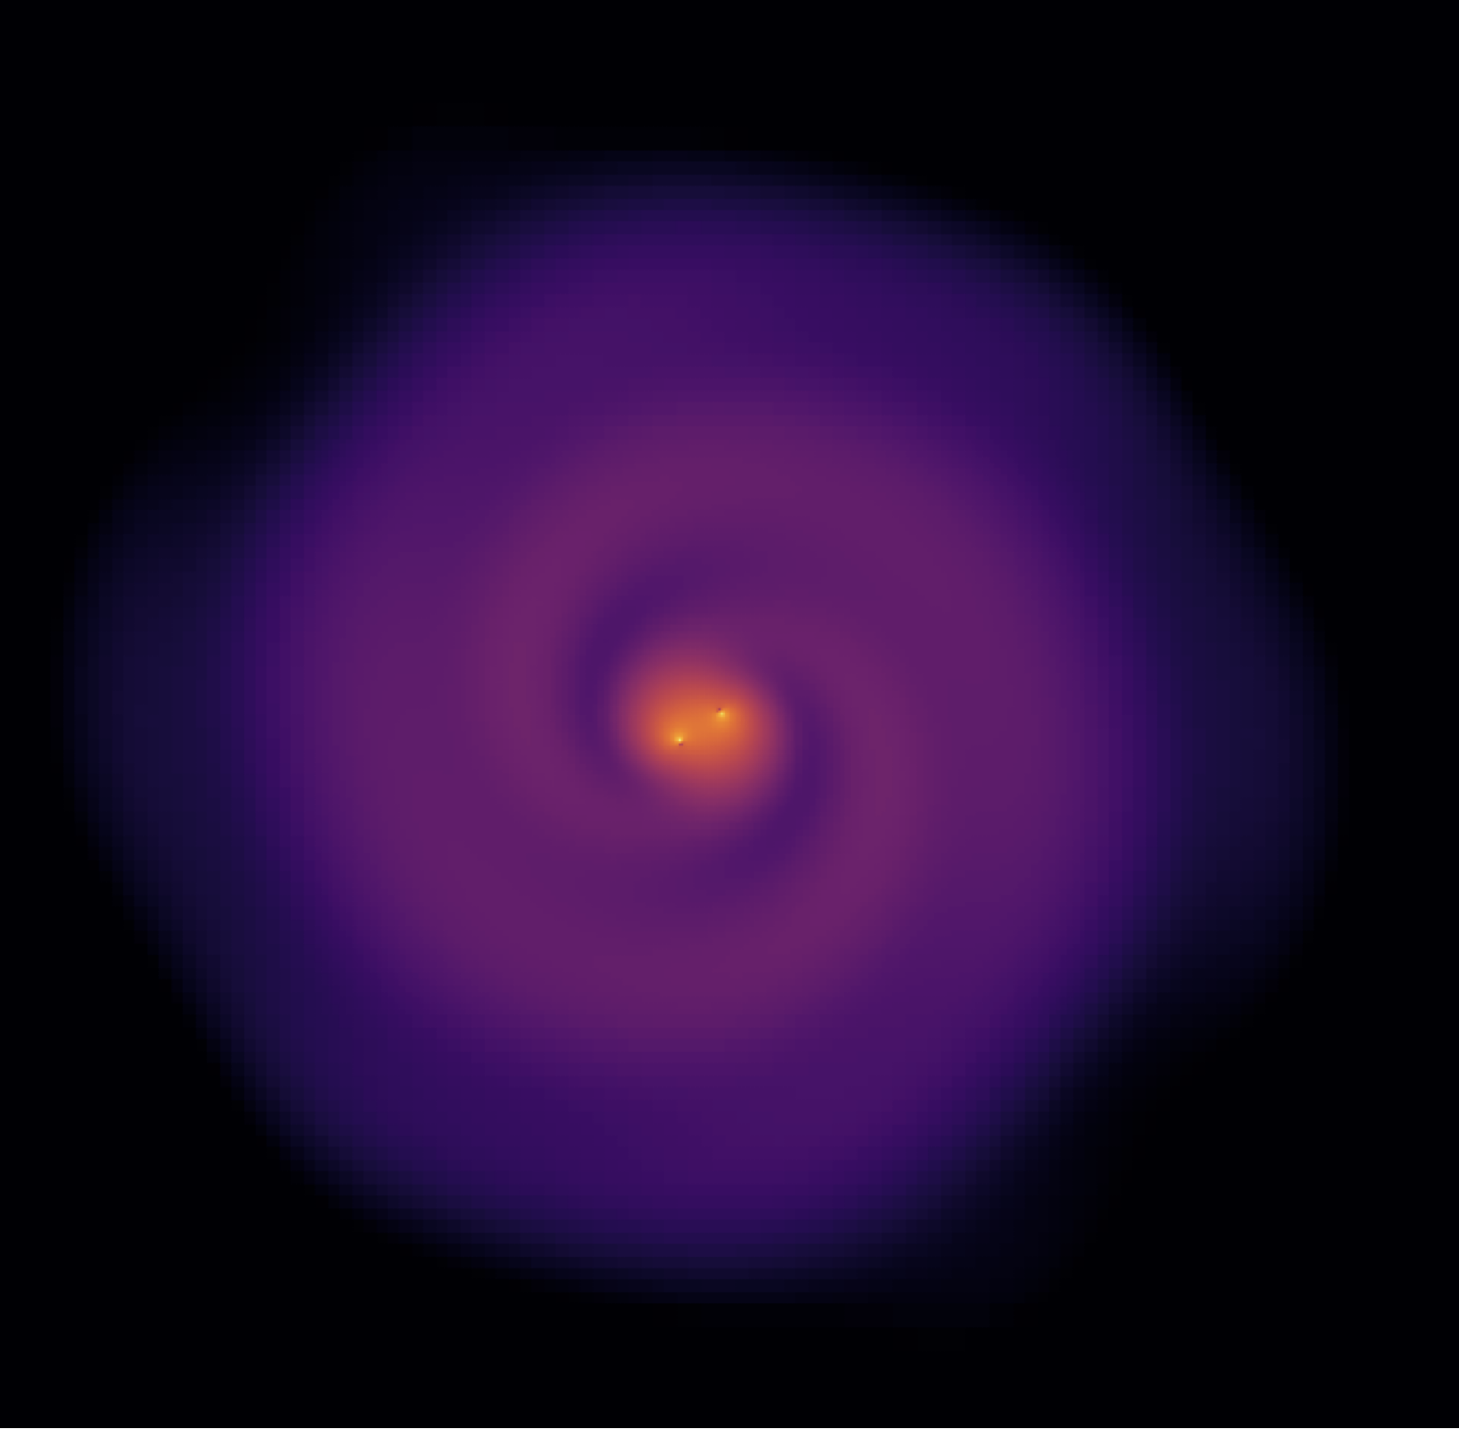
Scalar field accretion onto binaries
Katy Clough and friends

Slide 2
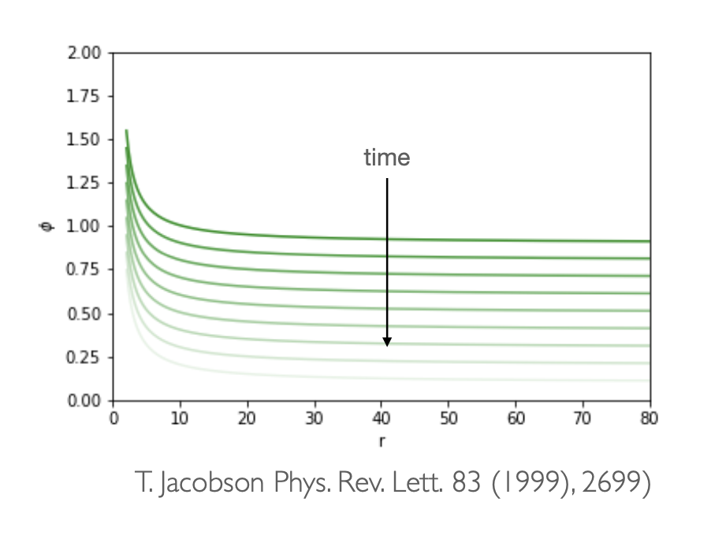
Evading the no hair theorem with time varying boundary condition

Slide 3
If the boundary time evolution is oscillatory?

Slide 4
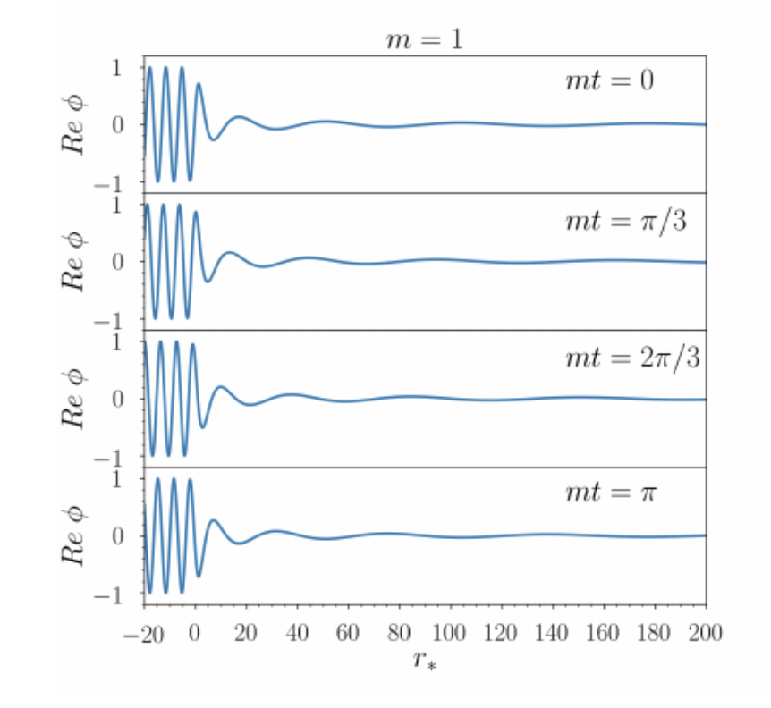
For a single BH, these are (roughly*) the confluent Heun functions
*The boundary conditions don’t match perfectly, so ours continue to grow

Slide 5
What about the binary case?

Slide 6
On fixed orbits the cloud stability is clearer

Slide 7
Solution persists to merger even when cut off

Slide 8
Appears to be different to the particle case

Slide 9
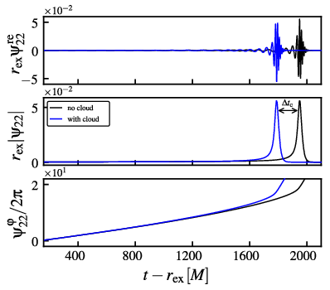
The presence of the cloud dephases the GWs

Slide 10
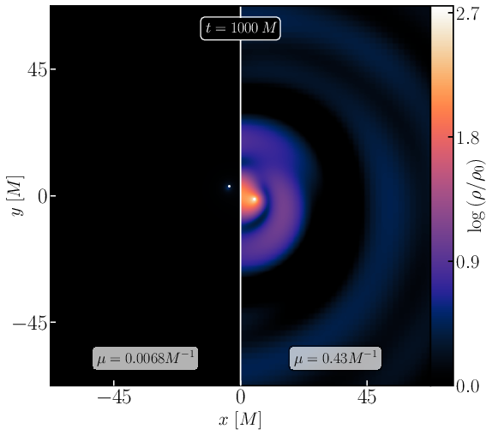
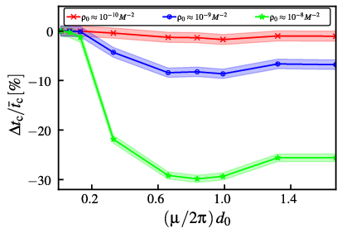
Dephasing maximised for wavelength similar to separation

Slide 11
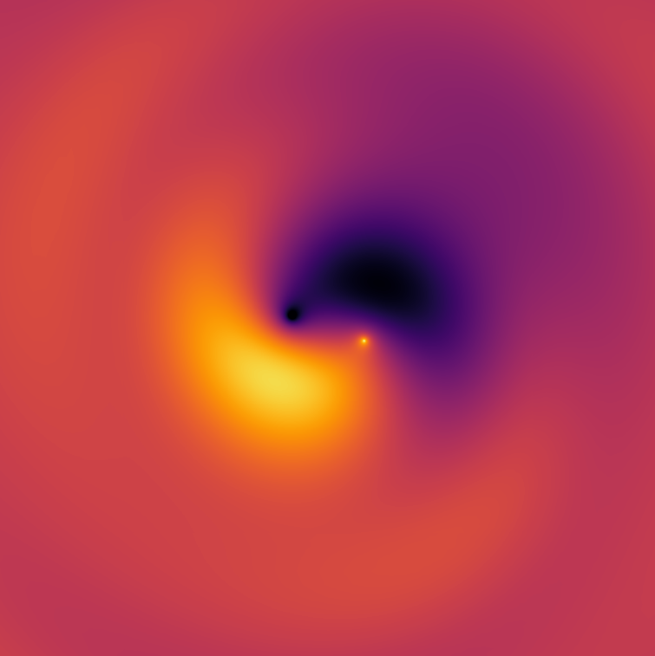
Is this a gravitational molecule?
Is this a bound state?
Not SR - the energy feeding the cloud comes from the accretion, not the binary
Nevertheless, there is a persistent configuration
Starting with a SR cloud around one of the BHs, I have seen states more similar to the ones shown in the toy model ->

