Slide 1
Cloud Mass Transfer and
Common Envelope Evolution
Jun Zhang (ICTP-AP)
in collaboration with Ao Guo and Huan Yang

Slide 2
Gravitoinal Atom in Binaries
energy levels

Slide 3
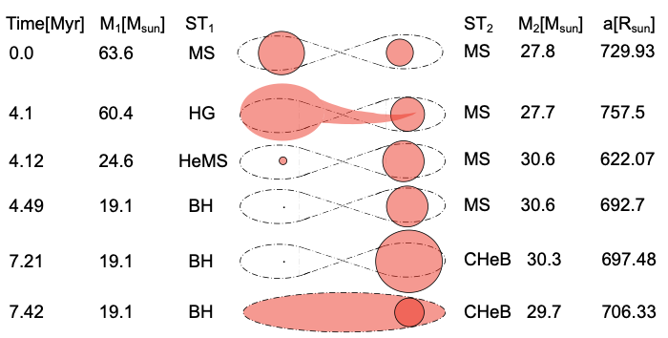
Evolution of Binary Stars

Slide 4
Gravitoinal Atom in Binaries
energy levels

Slide 5
Cloud Mass Transfer
Formalism

Slide 6
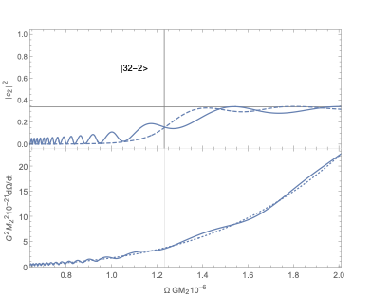
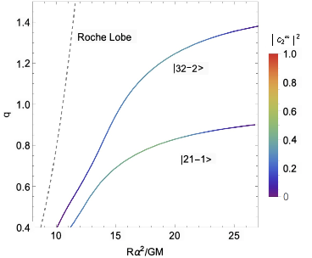
Cloud Mass Transfer
A two-mode model
Landau-Zener transition

Slide 7
Common Envelope Evolution
Bound states of gravitational molecule
[Ikeda, Bernard, Cardoso & Zilhão, PRD (2021)]
in the binary rest frame
with prolate spheroidal coordiantes

Slide 8
Common Envelope Evolution
Formation of cloud common envelope
[work in progress]
Gravitational atom in molecule states
e.g.
Evolution in inspiraling binaries

