Slide 1
Gravitational Molecules (with pen & paper)
Rodrigo Vicente (IFAE, Barcelona)
July 4th, 2024
New horizons for Psi (Lisbon, IST)

Slide 2
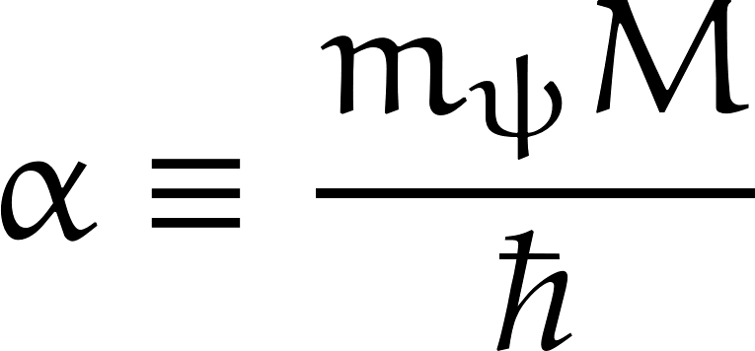
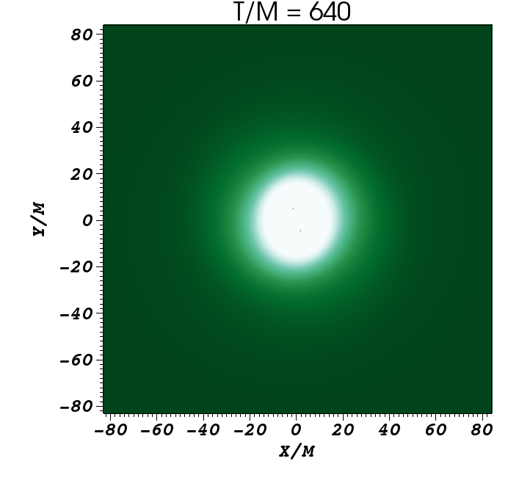
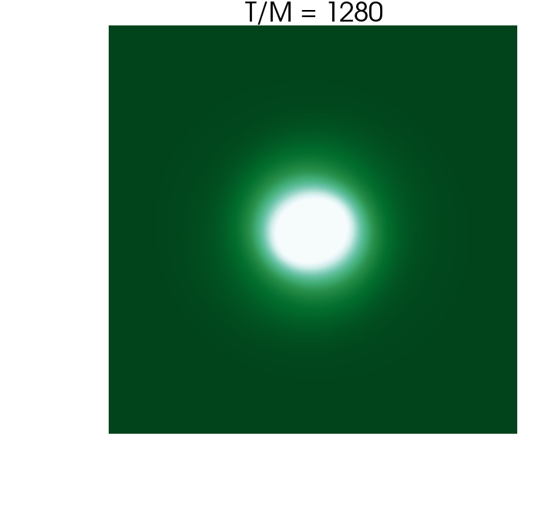
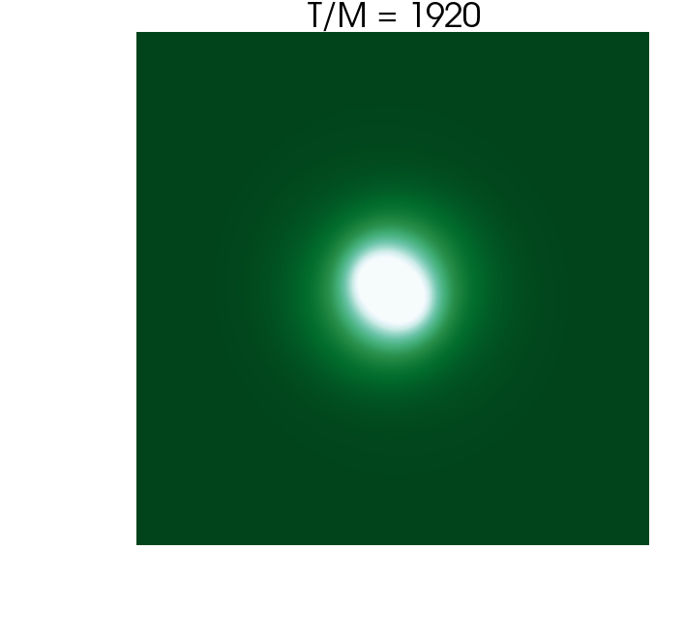
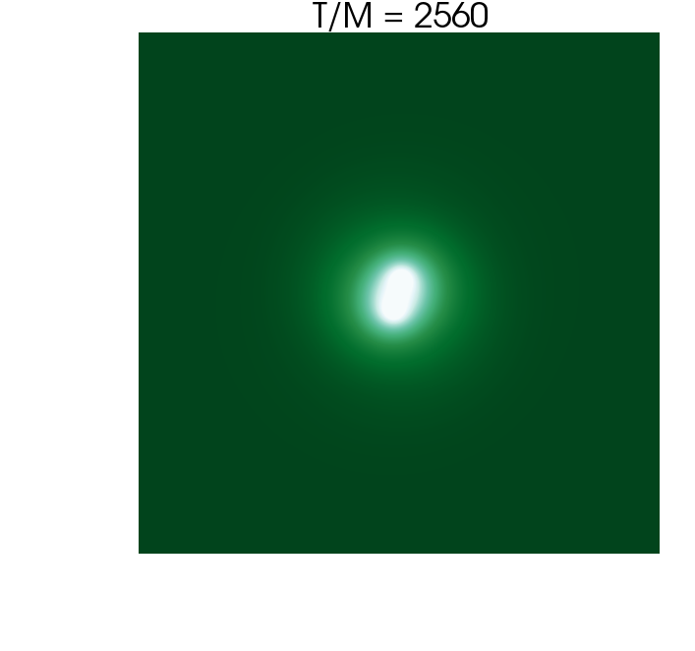
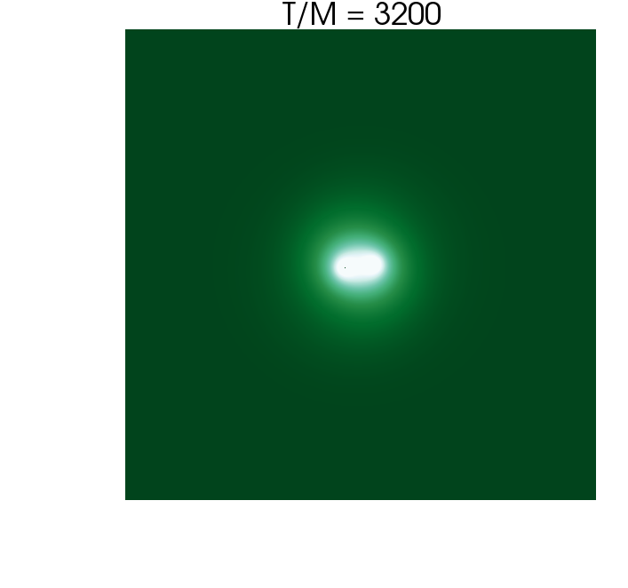
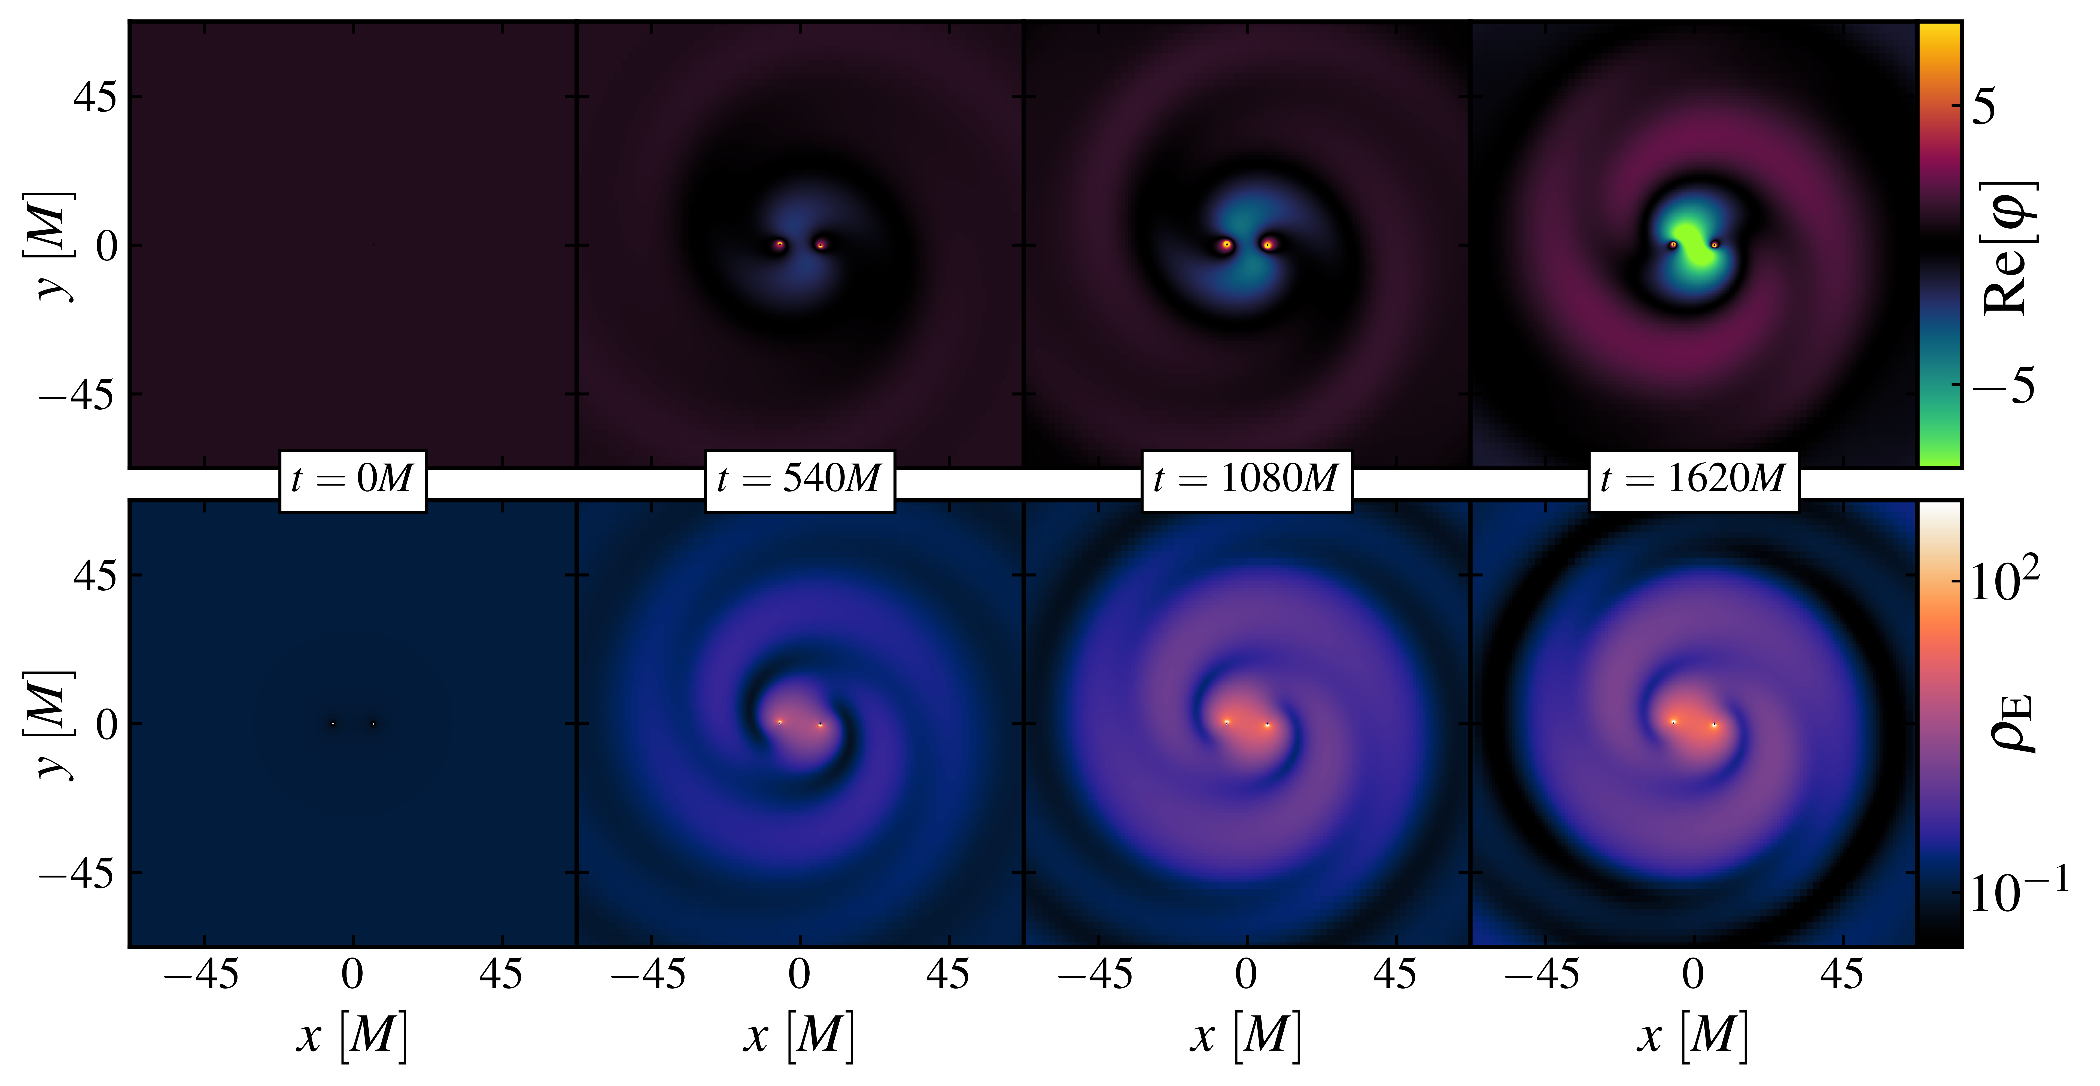
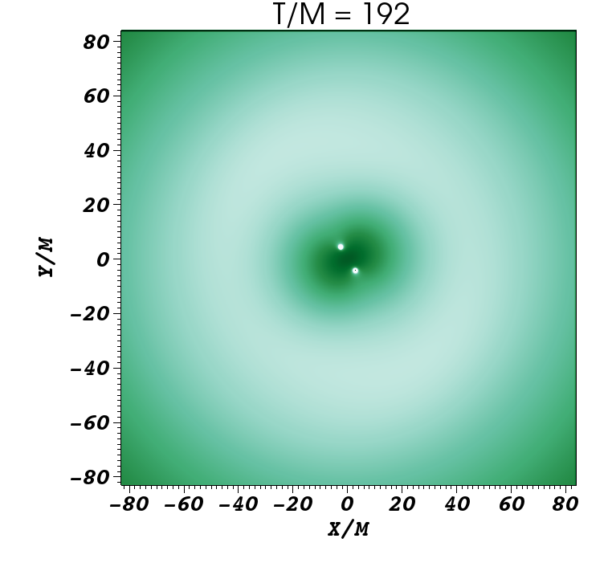
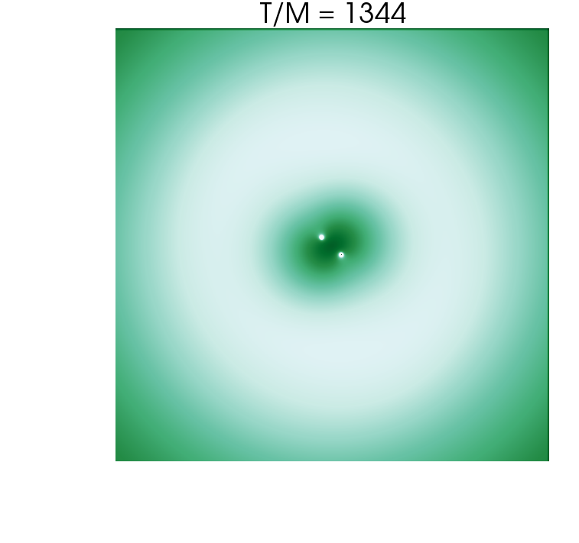
Gravitational Chemistry (the Molecule)
Bamber, et al. [2210.09254]
Ikeda, et al. [2010.00008]

Slide 3
EOMs (small coupling )
Wong [2004.03570], Endlich & Penco [1609.06723]
Wong [2004.03570]

Slide 4
Perturbation Scheme (set-up)

Slide 5
Perturbation Scheme (solution)
Wong [2004.03570]

Slide 6
Perturbation Scheme (final solution)

